Slide 1

Programming One (csc7050)
Aidan McGowan
OOP - Polymorphism

Slide 2
Polymorphism
The dictionary definition of polymorphism refers to a principle in biology in which an organism or species can have many different forms or stages. This principle can also be applied to object-oriented programming and languages like the Java language.
Subclasses of a class can define their own unique behaviours and yet share some of the same functionality of the parent class.

Slide 3

Polymorphism
One of the key concepts of OOP.
Polymorphism enables you to “program in the general” rather than “program in the specific.”

Slide 4
Polymorphism – two types
There are two types of polymorphism
Compile Time polymorphism
Run Time polymorphism
Runtime time polymorphism - uses inheritance and interfaces
Compile time polymorphism -method overloading

Slide 5
Runtime polymorphism or dynamic method dispatch
In Java, runtime polymorphism or dynamic method dispatch is a process in which a call to an overridden method is resolved at runtime rather than at compile-time.
In this process, an overridden method is called through the reference variable of a superclass. The determination of the method to be called is based on the object being referred to by the reference variable.
Notes:
Rules for Method Overriding:
applies only to inherited methods
object type (NOT reference variable type) determines which overridden method will be used at runtime
Overriding methods must have the same return type
Overriding method must not have more restrictive access modifier
Abstract methods must be overridden
Static and final methods cannot be overridden
Constructors cannot be overridden
It is also known as Runtime polymorphism.

Slide 6
Runtime Polymorphism
Enables programs to process objects that share the same superclass (either directly or indirectly) as if they’re all objects of the superclass.
This can simplify programming.

Slide 7




Cut… make incision, stop filming or snip hair ?
employee
Each subclass extends and implements the method cut()
Sending a message (invoking the method cut()) to each object will cause each object to execute the appropriate cut action
director
surgeon
barber

Slide 8
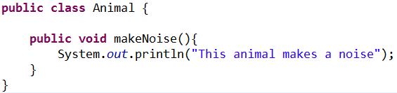
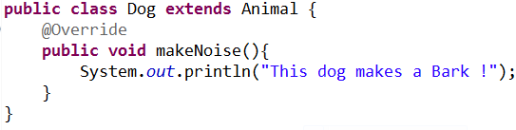
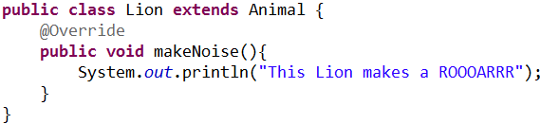
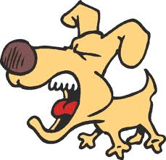

Animal Kingdom -polymorphic processing

Slide 9
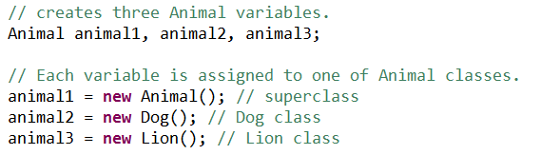
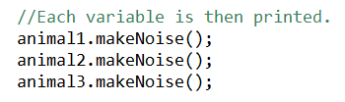

Animal Kingdom -polymorphic processing

Slide 10

The Java virtual machine (JVM) calls the appropriate method for the object that is referred to in each variable.
It does not call the method that is defined by the variable's type.
This behaviour is referred to as virtual method invocation and demonstrates an aspect of the important polymorphism feature in the Java language.

Slide 11
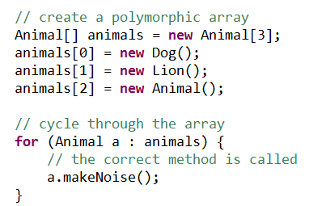

Animal Kingdom -polymorphic processing

Slide 12
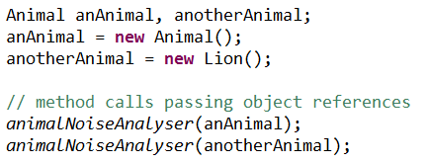

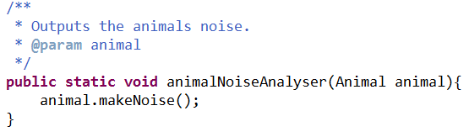
Polymorphic - Argument processing

Slide 13
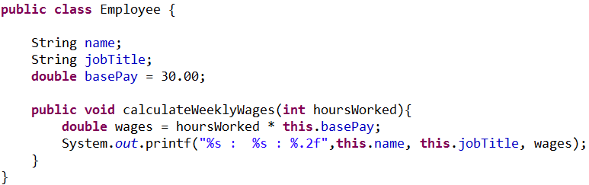
Payroll manager (polymorphic processing)

Slide 14
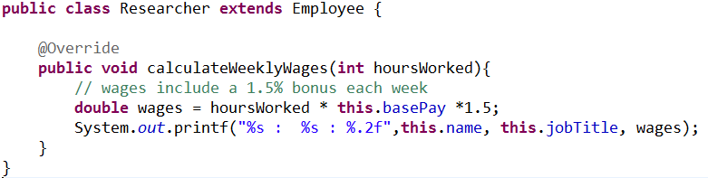
Payroll manager (polymorphic processing)

Slide 15
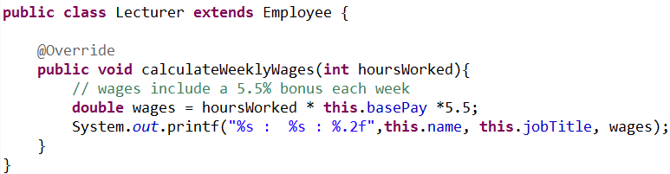
Payroll manager (polymorphic processing)

Slide 16
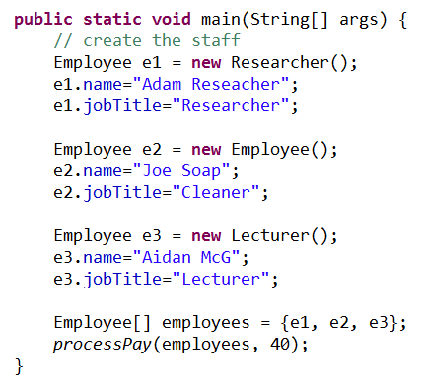

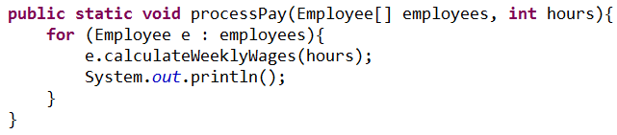
Payroll manager (polymorphic processing)

Slide 17
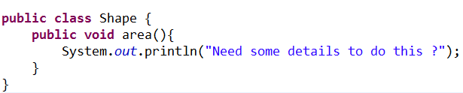

OOP Polymorphism - Exercise
Circle
- radius : double
+ area()
Rectangle
width : int height : int
+ area()
Triangle
base : double height : double
+ area()
1. For each of the subclasses override the area method and implement as appropriate for each shape type.
2. Create a class “ShapeFactory”. Within this class create a method with the following signature to use OO polymorphism techniques to calculate each shape’s area.
Notes:
package ShapesPoly;
public class Shape {
public Shape(){
}
public void area(){
System.out.println("Need some details to do this ?");
}
}
______________________________________________________________________________________________________________
package QuadrilateralsPoly;
public class Rectangle extends Shape {
private int height;
private int breadth;
/**
* Constructor
*/
public Rectangle(){
}
/**
* Constructor with args
* @param height
* @param breadth
*/
public Rectangle(int height, int breadth) {
this.height = height;
this.breadth = breadth;
}
/**
* @return the height
*/
public int getHeight() {
return height;
}
/**
* @param height the height to set
*/
public void setHeight(int height) {
this.height = height;
}
/**
* @return the breadth
*/
public int getBreadth() {
return breadth;
}
/**
* @param breadth the breadth to set
*/
public void setBreadth(int breadth) {
this.breadth = breadth;
}
@Override
public void area(){
System.out.println("Rectangle : "+this.height * this.breadth);
}
}
____________________________________________________________________________________________________________________
package QuadrilateralsPoly;
public class Circle extends Shape {
private double radius;
/**
* Constructor
*/
public Circle() {
}
/**
* Constructor with args
* @param radius
*/
public Circle(double radius) {
this.radius = radius;
}
/**
* @return the radius
*/
public double getRadius() {
return radius;
}
/**
* @param radius the radius to set
*/
public void setRadius(double radius) {
this.radius = radius;
}
@Override
public void area(){
System.out.println("Circle "+ (3.14 * this.radius * 2));
}
}
_________________________________________________________________________________________________________
package QuadrilateralsPoly;
public class ShapeFactory {
public static void main(String[] args) {
Shape shape = new Shape();
Shape r = new Rectangle(2,4);
Shape c = new Circle(3.1);
calculateArea(r);
calculateArea(c);
Shape[] shapes = new Shape[3];
shapes[0] = shape;
shapes[1] = r;
shapes[2] = c;
calculateArea(shapes);
}
/**
* Calculates the area of a given shape type
* @param s
*/
public static void calculateArea(Shape s){
s.area();
}
/**
* Calculates the area of given shape types in an array of shapes
* @param shapes
*/
public static void calculateArea(Shape[] shapes){
for (Shape s : shapes){
if (s!=null){
s.area();
}
}
}
}
__________________________________________________________________________________________________

